Slide 1
Module-2
Mrs. Harinakshi C

Slide 2
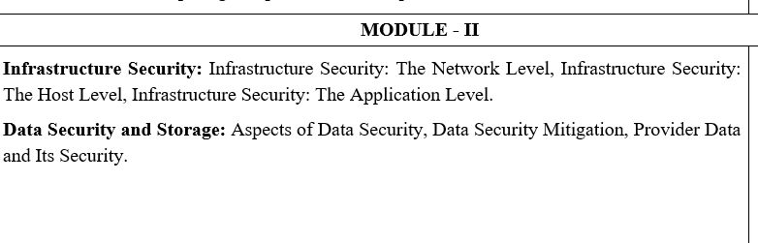

Slide 3
Infrastructure Security: The Network Level
When looking at the network level of infrastructure security, it is important to distinguish between public clouds and private clouds, With private clouds, there are no new attacks, vulnerabilities, or changes in risk specific to this topology that information security personnel need to consider.
The security considerations you have today apply to a private cloud infrastructure, too. And the security tools you have in place (or should have in place) are also necessary for a private cloud and operate in the same way.
Figure shows the topological similarities between a secure extranet and a private cloud.

Slide 4
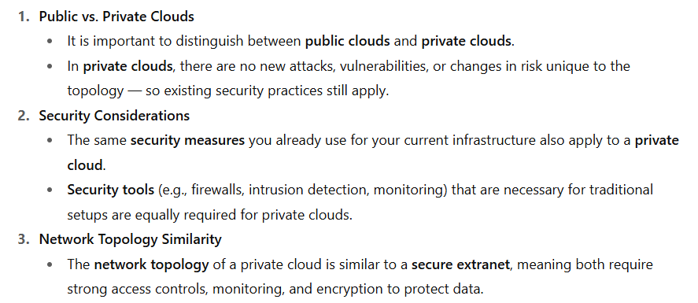

Slide 5
What is an extranet?
A secure extranet is basically a private network that allows controlled access to external partners (like suppliers, vendors, or business collaborators) using internet technologies, but with strong security controls such as authentication, encryption, and firewalls.
An intranet = internal private network for employees.
An extranet = extends part of that private network to trusted outsiders.
A secure extranet = does this safely, making sure only authorized external users can access certain resources.

Slide 6
Example:
A large enterprise (say a manufacturer) may set up a secure extranet so that its suppliers can:
Check raw material orders,
Update delivery schedules,
Share logistics data.
But the suppliers cannot see internal company data (like HR records, finances, or confidential projects). Security tools like VPNs, SSL encryption, and access control policies keep it safe.

Slide 7
Some use cases for extranets include the following examples:
Exchanging large volumes of data using electronic data interchange;
Sharing product catalogs exclusively with wholesalers;
Collaborating with other companies on joint development projects;
Jointly developing and using training programs with other companies;
Providing services to a group of other companies, such as an online banking application managed by one company on behalf of affiliated banks; and
Sharing news of common interest exclusively with partner companies.

Slide 8
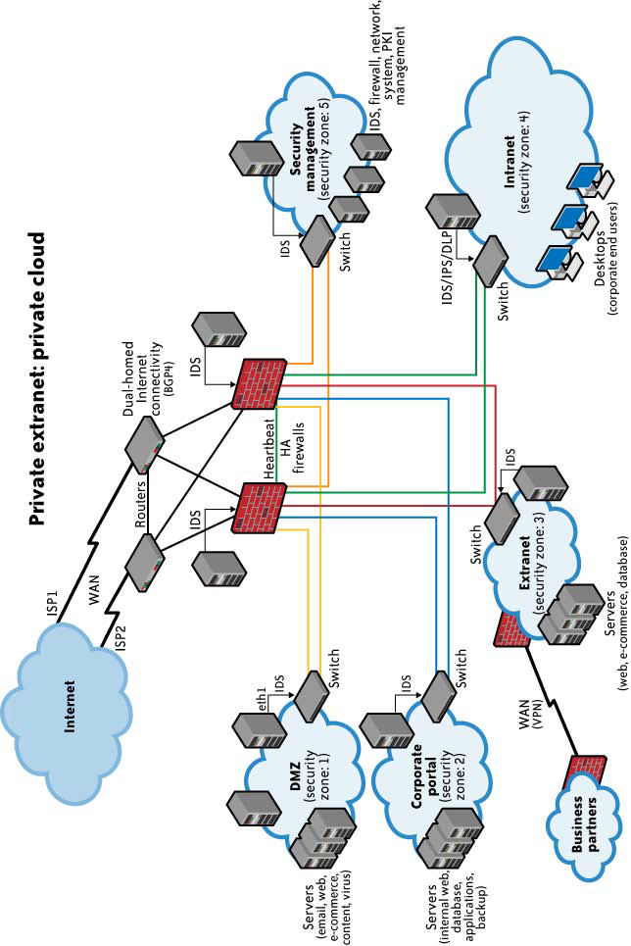
Generic network topology for private cloud computing

Slide 9
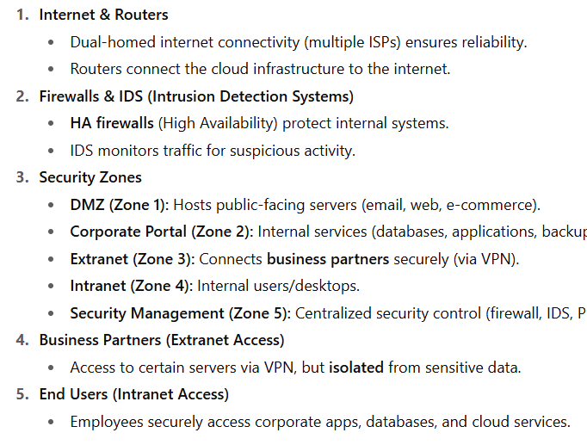

Slide 10
Why This Matters for Private Cloud Security
The segmentation into zones ensures attackers can’t easily move inside the network.
Firewalls, IDS/IPS, and DLP protect data at every layer.
Extranet access lets trusted partners in without exposing core corporate resources.

Slide 11
However, if you choose to use public cloud services, changing security requirements will require changes to your network topology.
Must address how your existing network topology interacts with your cloud provider’s network topology.
There are four significant risk factors in this use case:

Slide 12
There are four significant risk factors in this use case:
• Ensuring the confidentiality and integrity of your organization’s data-in-transit to and from your public cloud provider
• Ensuring proper access control (authentication, authorization, and auditing) to whatever resources you are using at your public cloud provider
• Ensuring the availability of the Internet-facing resources in a public cloud that are being used by your organization, or have been assigned to your organization by your public cloud providers
• Replacing the established model of network zones and tiers with domains- refers to a shift in network architecture design.

Slide 13
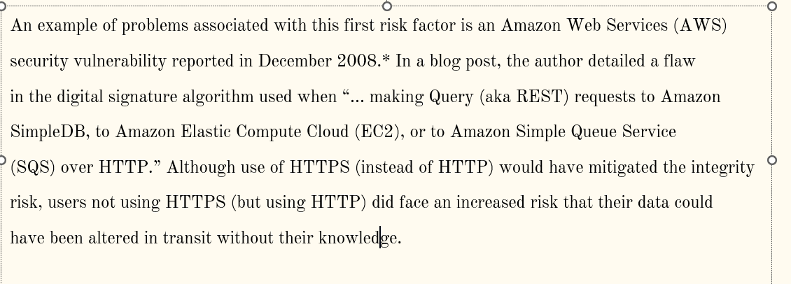
Ensuring Data Confidentiality and Integrity
Some resources and data previously confined to a private network are now exposed to the Internet, and to a shared public network belonging to a third-party cloud provider.

Slide 14
In December 2008, a security vulnerability was reported in Amazon Web Services (AWS).
The issue was with the digital signature algorithm used when sending Query (REST) requests to AWS services like:
Amazon SimpleDB (a database service)
Amazon EC2 (a compute service)
Amazon SQS (a messaging service)
Normally, AWS requests are digitally signed so that the server can confirm:
The request really came from the user.
The request was not altered while traveling across the internet.
The flaw meant that, when these requests were sent using HTTP (which is unencrypted), there was a chance that an attacker could intercept the request and alter it while in transit.
Example: If you send a request to start a virtual machine or store data, an attacker could change the request before it reached AWS.

Slide 15
However, if users sent requests via HTTPS (encrypted communication), the encryption would protect the integrity of the data. This would mitigate the risk, because even if someone intercepted the data, they wouldn’t be able to read or modify it.
The problem was that not all users enabled HTTPS, and those using HTTP were at risk.

Slide 16
AWS S3 Data Breaches (2017–2018)
Multiple companies (Accenture, Dow Jones, Verizon, U.S. Army intelligence documents) exposed data due to misconfigured Amazon S3 buckets.
Some buckets allowed public HTTP access without authentication, meaning data could be read or altered.
Like the 2008 case, the lack of strong authentication/encryption created integrity and confidentiality risks.

Slide 17
Access Control in Public Cloud
When an organization uses a public cloud:
Its resources (servers, storage, databases, etc.) are exposed to the Internet.
Unlike in a private data center, the company has little or no ability to monitor network traffic at the provider’s level.
They have less visibility into logs, forensics, or investigations.
So, access control becomes harder to enforce and audit.

Slide 18
Example Problem: Reused (Reassigned) IP Addresses
IP addresses are limited and expensive resources.
Cloud providers (like AWS, Azure, GCP) recycle IP addresses: when one customer releases an IP, it’s quickly reassigned to another customer.
This practice makes sense for providers but creates security risks for customers.

Slide 19
Mitigating IP Address Reassignment Risks
Risks of Non-Aged IP Addresses:
Persistence in Caches: Old IPs may remain in DNS/ARP caches, leading to unauthorized access.
Lag Time Issues: Delays in updating caches can result in access to outdated IPs.
AWS Elastic IP Solution:
Customer Control: AWS introduced Elastic IPs, allowing customers to manage IP assignments.
Best Practices:
Monitoring: Use tools to track DNS/ARP updates.
Proactive Security: Clear caches regularly and push for robust IP aging policies.

Slide 20
Example: 1
An example of the problems associated with this second risk factor is the issue of reused (reassigned) IP addresses.
Generally speaking, cloud providers do not sufficiently “age” IP addresses when they are no longer needed for one customer. Addresses are usually reassigned and reused by other customers as they become available.
From a cloud provider’s perspective this makes sense. IP addresses are a finite quantity and a billable asset.
However, from a customer’s security perspective, the persistence of IP addresses that are no longer in use can present a problem.
A customer can’t assume that network access to its resources is terminated upon release of its IP address.
There is necessarily a lag time between the change of an IP address in DNS and the clearing of that address in DNS caches.

Slide 21
Example: 2
There is a similar lag time between when physical (i.e., MAC) addresses are changed in ARP tables and when old ARP addresses are cleared from cache; an old address persists in ARP caches until they are cleared.
This means that even though addresses might have been changed, the (now) old addresses are still available in cache, and therefore they still allow users to reach these supposedly non-existent resources.

Slide 22
Ensuring the Availability of Internet-Facing Resources
Reliance on network security has increased because an increased amount of data or an increased number of organizational personnel now depend on externally hosted devices to ensure the availability of cloud-provided resources.
Example:
BGP prefix hijacking
DNS attacks

Slide 23
Prefix hijacking
Prefix hijacking involves announcing an autonomous system‡ address space that belongs to someone else without her permission.
Such announcements often occur because of a configuration mistake, but that misconfiguration may still affect the availability of your cloud-based resources.

Slide 24
What it is: Border Gateway Protocol (BGP) is the “map of the Internet” used by ISPs to decide how to route traffic.
Attackers can announce fake routes to redirect traffic through their network.
Impact: Traffic can be dropped (causing downtime) or intercepted (enabling spying).
Real Incident: In 2018, attackers hijacked Amazon’s Route 53 BGP prefixes. They redirected traffic to fake cryptocurrency sites and stole $150,000 in Ethereum.

Slide 25
Prefix hijacking-Example-2
A NANOG 2006 study showed that several hundred BGP misconfigurations occur each month.
The most famous case happened in February 2008 when Pakistan Telecom mistakenly announced a bogus route for YouTube to its upstream provider PCCW (Hong Kong).
The original intent was to block YouTube only within Pakistan due to controversial videos.
Instead, the route spread globally, causing YouTube to be inaccessible worldwide for about two hours.
In short: A local filtering attempt in Pakistan accidentally triggered a global BGP hijack, knocking YouTube offline worldwide for 2 hours.

Slide 26
DNS ATTACK
What is DNS?DNS is like the phonebook of the internet.
It translates human-readable domain names (like www.google.com) into IP addresses (like 142.250.182.14) that computers use to communicate.
Without DNS, we would have to remember long strings of numbers (IP addresses) to access websites.

Slide 27
Steps
You type www.google.com into your browser.
Your computer asks the DNS resolver (usually provided by your ISP or a public DNS like Google DNS 8.8.8.8) to find the IP address.
The resolver checks its cache; if not found, it queries the DNS hierarchy:
Root server → sends to .com TLD server.
.com server → sends to Google’s authoritative DNS server.
Google’s DNS server → replies with the IP (e.g., 142.250.182.14).
The resolver gives the IP to your browser.
Your browser connects to Google’s server using the IP.

Slide 28
DNS Attacks and Cloud Computing – Risks and Vulnerabilities
DNS and Cloud Computing Risks:
Common DNS Attacks in Cloud Computing:
Vulnerabilities in DNS Protocol and Implementations:

Slide 29
DNS Attacks and Cloud Computing – Risks and Vulnerabilities
1. Increased External DNS Querying
Cloud platforms rely heavily on DNS to locate and connect services (e.g., storage buckets, load balancers, APIs).
This creates frequent external DNS queries that increase the chance of interception, spoofing, or manipulation.
Attackers can target DNS traffic to redirect users to malicious endpoints.

Slide 30
2. Dependency on Network Security
Cloud services often involve distributed teams and multiple networks (corporate, remote, third-party).
Each network layer depends on DNS, making the overall system more vulnerable to attacks like DNS poisoning or cache hijacking.
Misconfigured DNS can expose sensitive workloads or enable unauthorized access.

Slide 31
3.Split Horizon DNS Ineffectiveness
Split horizon DNS (different answers for internal vs. external queries) is a common security practice on-premises.
In cloud environments, external DNS traffic often bypasses these controls, making internal protections less effective.
This increases the risk of data leakage, phishing redirection, or service disruption.

Slide 32
Common DNS Attacks in Cloud Computing
DNS Cache Poisoning
Attackers inject false DNS records into a resolver’s cache.
Causes users to be redirected to malicious IPs instead of legitimate ones.
Example: Users typing www.bank.com may be redirected to a fake phishing site.
DNS Forgery (DNS Response Forging)
Attackers send fake DNS responses faster than the legitimate server.
Often targets Name Server (NS) records, replacing them with attacker-controlled servers.
Impact: Large-scale redirection of domains under a compromised DNS zone.
DNS Spoofing (Man-in-the-Middle)
Attackers intercept DNS requests in transit and modify the responses.
Redirects users to malicious sites without altering the resolver’s cache.
Often combined with packet sniffing or compromised routers.

Slide 33
Vulnerabilities in DNS Protocol and Implementations
1. Protocol Vulnerabilities
DNS was designed in the early 1980s with a focus on functionality, not security.
Inherent weaknesses include:
Lack of authentication → DNS can’t verify if responses come from a trusted source.
Susceptible to spoofing/forgery → attackers can inject false records.
Caching exploitation → poisoned or stale records persist in cache, redirecting traffic.
No confidentiality → DNS queries/responses are usually unencrypted (exposed to eavesdropping).
These flaws make DNS an attractive target for cache poisoning, spoofing, and man-in-the-middle attacks.

Slide 34
2. Implementation Issues
Even when the protocol is used correctly, poorly implemented DNS software or configurations increase risk.
Examples:
Default configurations with open resolvers → allow amplification attacks (DDoS).
Improper access controls → attackers can query or modify records.
Unpatched DNS servers → contain exploitable bugs (e.g., buffer overflows).
Weak logging and monitoring → delays detection of hijacking or poisoning attempts.
Real-world failures often come from misconfigurations or negligence, not just protocol flaws.

Slide 35
Mitigation and Prevention Strategies for DNS Attacks in Cloud Computing
1. Notable DNS Vulnerabilities:
Kaminsky Bug (CVE-2008-1447):
Vulnerability in DNS insufficient socket entropy, leading to cache poisoning attacks.
Highlighted the ease of tricking DNS servers into accepting bad information.
Persistent DNS Cache Poisoning:
Despite earlier fixes, DNS cache poisoning remains a significant threat in cloud environments.

Slide 36
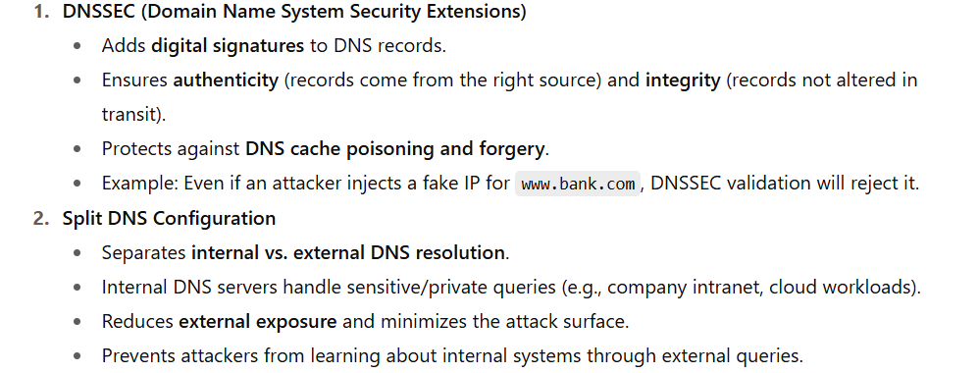
2. Key Mitigation Strategies:

Slide 37
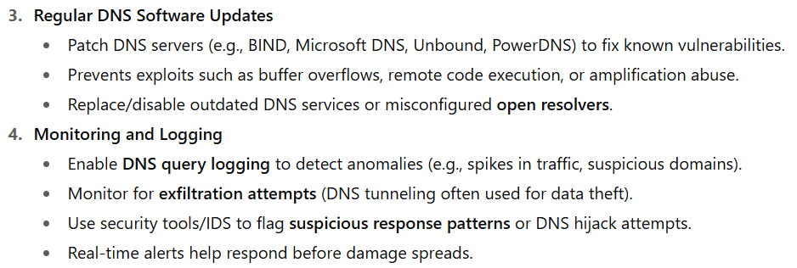

Slide 38
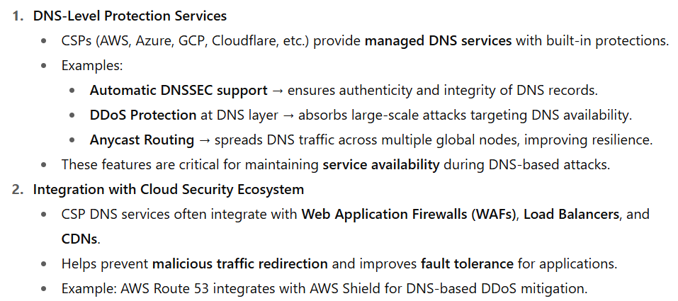
3. Role of Cloud Service Providers (CSPs) in DNS Security

Slide 39
Distributed Denial of Service (DDoS)
A Distributed Denial of Service (DDoS) attack is a type of cyberattack in which multiple compromised devices, often spread across different locations, are used to overwhelm a target (such as a server, website, or network) with a massive flood of internet traffic.
The goal of a DDoS attack is to make the target's services unavailable to its legitimate users by exhausting its resources, such as bandwidth, processing power, or memory.

Slide 40
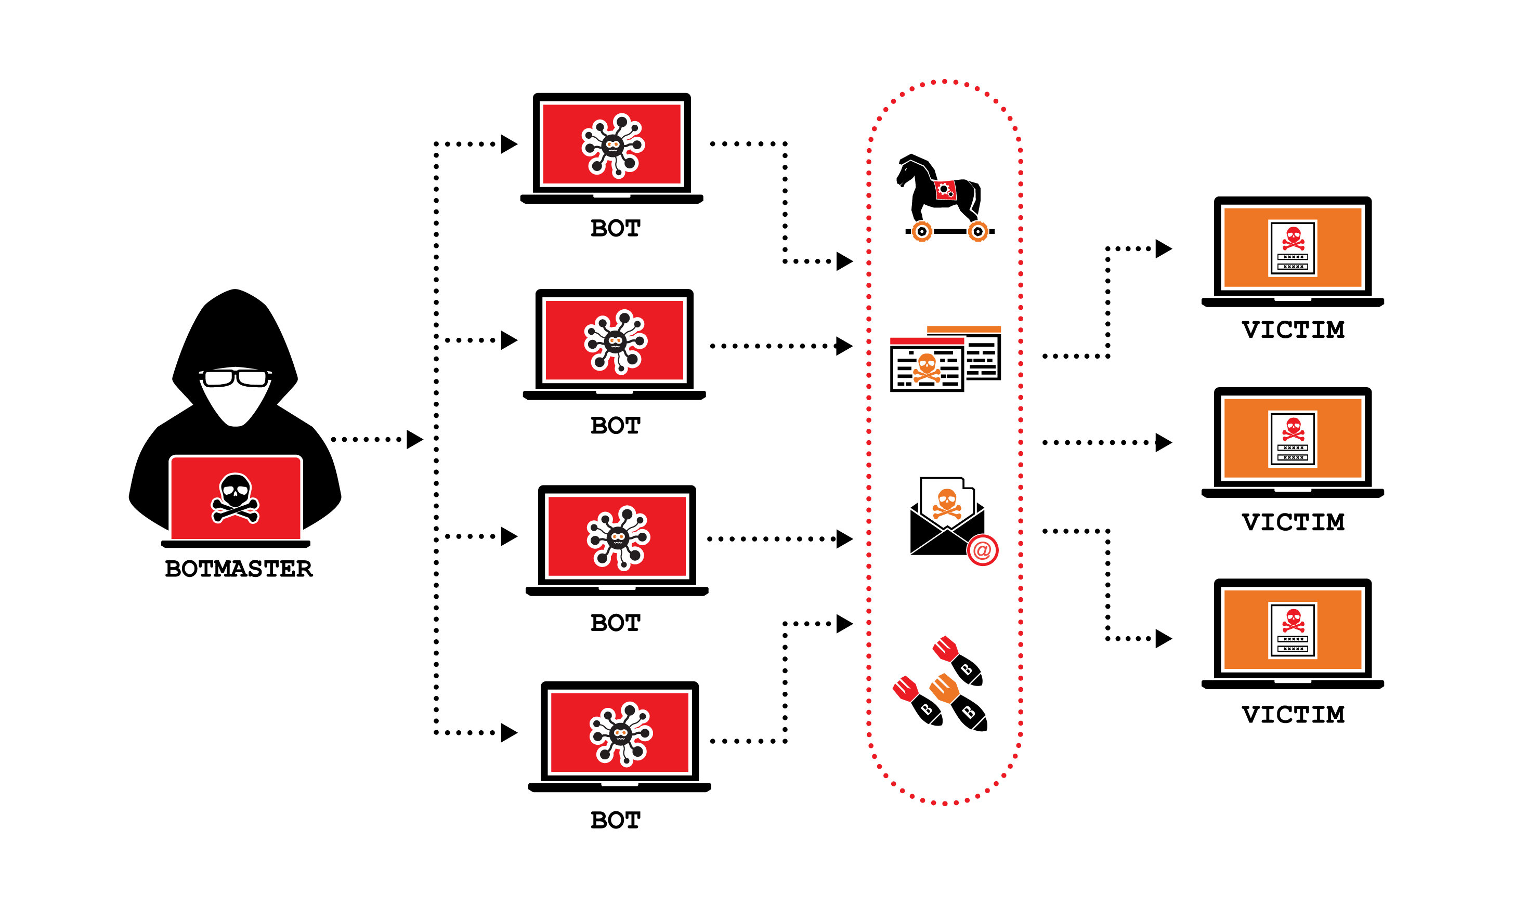
DDoS = Distributed Denial of Service
Attackers use multiple compromised systems (botnets, IoT devices, malware-infected PCs) to flood a target with traffic.
Goal: Overwhelm the target’s resources (bandwidth, CPU, memory, application capacity), making services slow or completely unavailable to legitimate users.

Slide 41
Key Aspects of DDoS Attacks
Distributed Nature: DDoS attacks involve multiple systems, often part of a botnet (a network of infected computers), which makes it harder to stop the attack by blocking a single source of traffic.
Flooding the Target: The attackers flood the target system with fake requests, preventing it from processing legitimate requests.
Impact:
Service downtime and unavailability.
Loss of revenue for businesses due to interrupted operations.
Damage to reputation if the attack is public and sustained.

Slide 42
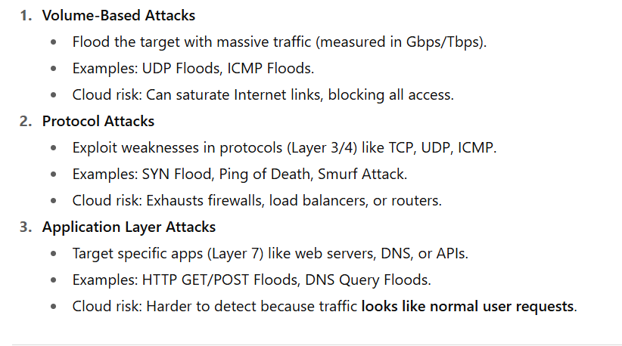
Types of DDoS Attacks:

Slide 43
Mitigating DDoS Attacks:
1. CSP Protections (Cloud Service Provider Protections)
Examples: AWS Shield, Azure DDoS Protection, Google Cloud Armor.
These are built-in protections by cloud providers that automatically detect unusual traffic spikes.
They analyze patterns in traffic and block malicious floods before they reach your application. Example: AWS Shield detects a sudden 1 million requests/second to your EC2 instance and automatically filters them before they overload your server.

Slide 44
2. CDN & Anycast
CDN (Content Delivery Network): Distributes your website content across multiple global servers. Users connect to the nearest server instead of one central server.
Anycast: A networking method where a single IP address routes users to the closest or healthiest server in a global network. Example: If your website uses Cloudflare or AWS CloudFront, traffic from India hits the nearest CDN server in India, while US users connect to US servers. This distributes load and makes DDoS harder.

Slide 45
3. Auto-Scaling
Cloud automatically adds more servers/resources when there’s a traffic spike.
It helps absorb sudden increases in load, whether from legitimate users or attackers.
Limitation: It can’t protect against very large DDoS attacks forever (you’ll hit cost or service limits). Example: If your web app usually runs on 2 servers, but traffic jumps, Azure automatically scales it to 10 servers to handle requests.

Slide 46
4. Rate Limiting & WAFs
Rate Limiting: Restricts how many requests a user/IP can make in a certain time. Prevents flooding.
WAF (Web Application Firewall): Filters HTTP(S) traffic, blocking suspicious requests (like SQL injection, bots, or floods). Example: A user tries to send 1000 login attempts per second. Rate limiting blocks them after 10 requests. A WAF may also detect and block attack patterns like malicious scripts.

Slide 47
5. Traffic Scrubbing Centers
Specialized cloud security services where suspicious traffic is redirected for cleaning (scrubbing) before it reaches your app.
They separate good traffic (real users) from bad traffic (bots/attackers). Example: Akamai or Cloudflare scrubbing center filters out a botnet DDoS attack so only valid requests reach your application servers.

Slide 48
Key Points on Internal DDoS Attacks in IaaS:
External DDoS Attacks:
Suppose a company hosts its e-commerce website on AWS EC2.
An attacker from outside (internet) launches a botnet attack using thousands of compromised devices to flood the website’s public IP with traffic.
Result: The website becomes slow or unavailable for legitimate customers.
This is External DDoS because the attack originates from outside the cloud provider’s infrastructure and targets a public-facing service.

Slide 49
Internal DDoS Attack Example
1. Internal Attack
Consider multiple customers sharing the same IaaS cloud infrastructure (multi-tenancy).
A rogue customer rents a VM in Azure.
Instead of using it legitimately, they run a malicious program that floods another customer’s VM or the cloud provider’s internal services (like storage or DNS inside Azure).
Since the attack is happening inside the provider’s private/internal network, traditional internet firewalls may not detect it.
Result: Other tenants (customers) suffer degraded performance or outages.
This is Internal DDoS because the attacker is already inside the provider’s environment and exploits the shared internal network.

Slide 50
Key Difference
External → Attack from internet → Targets public services.
Internal → Attack from inside cloud → Targets other tenants or provider infrastructure.

Slide 51
2. Risks in IaaS Networks:
Shared Resources: In an IaaS environment, customers share portions of the network that handle both public-facing and internal operations (e.g., managing Amazon Machine Images (AMIs), access to non-public instances). This creates an opportunity for internal attacks.
Non-Routable Networks: These are private, internal networks not visible from the public internet but critical for managing cloud infrastructure. A malicious customer could launch a DDoS attack from within, targeting other tenants or the provider's systems.

Slide 52
3. Potential Attack Vectors:
Overloading Internal Networks: By consuming excessive bandwidth or generating too many requests, an attacker could disrupt communication between the IaaS provider and other customers.
Targeting Non-Public Instances: Since customers often use non-public instances for sensitive workloads, attackers might attempt to overload these systems through internal DDoS mechanisms.
Compromising Provider Infrastructure: A rogue tenant could attack the IaaS provider’s management systems (such as those controlling physical servers or network management) to degrade performance or cause outages.

Slide 53
4. Lack of Detection and Prevention:
Detective Controls: The IaaS provider might lack adequate monitoring for internal attacks, especially if the attack traffic is not routed through the internet.
Preventive Controls for Customers: The only defense for customers in many cases is the hardening of their instances, ensuring that internal services and access points are secured.

Slide 54
Preventive Strategies for Internal DDoS in IaaS:
Instance Hardening:
Secure non-public instances (such as AMIs) by applying strict firewall rules and access controls.
Regularly update and patch software to prevent known vulnerabilities from being exploited.
Segmentation and Firewalls:
Use network segmentation to isolate sensitive workloads from the rest of the internal network.
Implement firewalls or security groups (e.g., AWS Security Groups) to control traffic flow between instances.

Slide 55
3. Monitoring and Intrusion Detection:
Use advanced monitoring tools or third-party services to detect unusual traffic patterns or resource consumption within the internal network.
Implement intrusion detection systems (IDS) to monitor network activity for signs of malicious behavior

Slide 56
4. Collaboration with Providers:
Work with the IaaS provider to ensure they are monitoring their internal networks for potential attacks and have systems in place to alert customers of any suspicious activity.
Request additional security services, such as DDoS protection or managed firewall services, that can help mitigate attacks.

Slide 57
Replacing the Established Model of Network Zones and Tiers with Domains
Traditional Model: Network Zones and Tiers
Earlier, networks were divided into zones such as:
External (Internet) – completely untrusted.
DMZ (Demilitarized Zone) – semi-trusted area where public-facing apps (e.g., web servers) are hosted.
Internal Network – highly trusted area (databases, internal apps, employees).
Security was enforced by firewalls and access control lists between these zones. This model assumes a clear inside vs outside boundary.

Slide 58
Problem with the Old Model
In cloud and modern distributed systems, boundaries are blurry:
Users connect from anywhere (not just corporate LAN).
Services may run across multiple cloud providers.
Meaning → the concept of "inside is trusted, outside is untrusted" no longer works.

Slide 59
New Model: Domains
Instead of broad zones, we move towards domains of trust.
A domain is defined by identity, context, and security policy, not just network location.
Example domains:
User Domain → defines trust level of users based on MFA, device posture, etc.
Application Domain → microservices and apps controlled by IAM + Zero Trust.
Data Domain → access to sensitive data controlled by encryption + RBAC.
This is aligned with the Zero Trust Model, where no implicit trust is given based on network location. Each access request must be authenticated and authorized individually.

Slide 60
Example
In old model:
If a device is inside corporate LAN, it’s trusted.
Attackers who compromise one internal machine can move laterally easily.
In new model (domains):
Even if inside the network, each request from that device must prove identity, meet security conditions, and be authorized.
Example: A developer’s laptop inside office still needs MFA + device compliance to access the source code repo.

Slide 61
Private Cloud Advantages:
1. Reduced Risks:
A private cloud, particularly one internal to your organization’s network, reduces many risks compared to public clouds. Since resources are dedicated and isolated, potential security threats from other tenants are minimized.
Private clouds hosted at a cloud provider's facility still reduce risks but to a lesser extent, depending on the provider's security capabilities and maturity.

Slide 62
2. Encryption and Confidentiality:
Encryption for Data-in-Transit: Encrypting data as it moves between systems is crucial for maintaining confidentiality. Using validated cryptographic implementations (like AES, TLS) ensures that data remains secure against interception and unauthorized access.
Digital Signatures: Digital signatures ensure the integrity of data by making it nearly impossible to tamper with. This provides verifiable proof that the data has not been altered.

Slide 63
Infrastructure Security: The Host Level
Cloud Delivery Model
Consider security risks across SaaS, PaaS, and IaaS delivery models, and deployment models (public, private, hybrid).
Virtualization Security Threats
Existing threats like VM escape, system configuration drift, and insider threats (via weak access control to hypervisors) extend into cloud environments.
Elasticity of Cloud Computing:
The dynamic nature of cloud environments creates challenges in security management due to rapid provisioning and short-lived VMs.

Slide 64
Vulnerability Management:
Managing vulnerabilities and patches is more complex than in traditional data centers due to the high rate of change.
Velocity of Attack:
Cloud environments with many compute nodes and homogeneous operating systems can amplify security threats quickly.
Trust Boundaries:
Distinguish between your security responsibilities as a host manager and the cloud service provider’s (CSP) responsibilities in managing host infrastructure security.

Slide 65
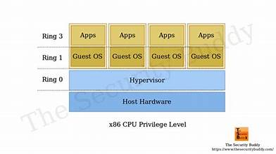
VM escape
A VM escape occurs when an attacker exploits a vulnerability in the virtualization software or guest operating system to gain control over the hypervisor or host system.
By doing so, they can penetrate the entire virtualized environment and potentially compromise all other virtual machines running on the same host.

Slide 66
System configuration drift
Configuration drift is when configurations in an IT system gradually change over time.
Drift is often unintentional and happens when undocumented or unapproved changes are made to software, hardware, and operating systems.
It can have an impact on system performance and security.

Slide 67
The dynamic nature (elasticity)
Elasticity in Cloud Cloud computing allows resources (like Virtual Machines, storage, etc.) to scale up or down very quickly depending on demand.
Security Challenge Because resources are created and destroyed rapidly, traditional security methods (like manual patching, slow vulnerability scanning) don’t keep up.
Rapid provisioning: New VMs appear/disappear in seconds.
Difficult patch management: Vulnerabilities can spread before patches are applied.
High rate of change: Much faster than in a traditional data center.
Key Point → Elasticity improves efficiency but makes security management harder.

Slide 68
Velocity of Attack in the Cloud
Amplified Threats Clouds use thousands of compute nodes with similar operating systems.
This uniformity means a single vulnerability can spread very fast. → This is called the “velocity of attack” in cloud environments.
Shared Responsibility
Customers (you) must secure the part of the infrastructure you manage
(e.g., applications, user access, configurations).
Cloud Service Providers (CSPs) secure the underlying infrastructure
(e.g., hardware, hypervisor, data center security).
Remember : You must clearly understand the trust boundary
—where your responsibility ends and the CSP’s responsibility begins.

Slide 69
Cloud elasticity = speed + flexibility, but also rapid attack surface changes.
Security must adapt to this fast-paced environment with automation,
continuous monitoring, and shared responsibility.

Slide 70
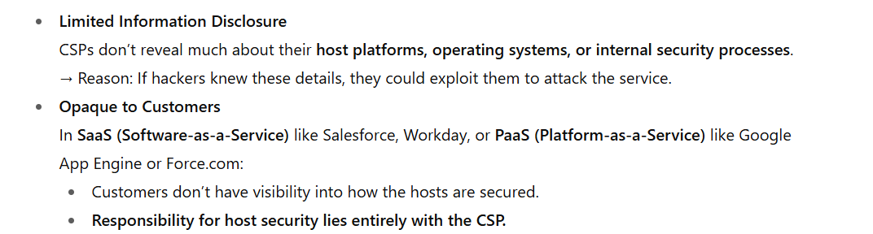
SaaS and PaaS Host Security

Slide 71
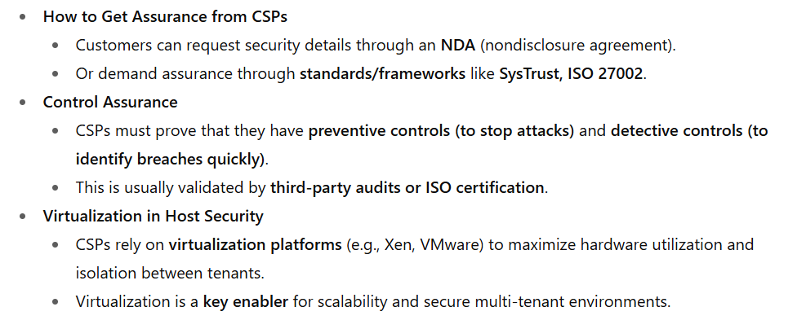
Assurance and Virtualization

Slide 72
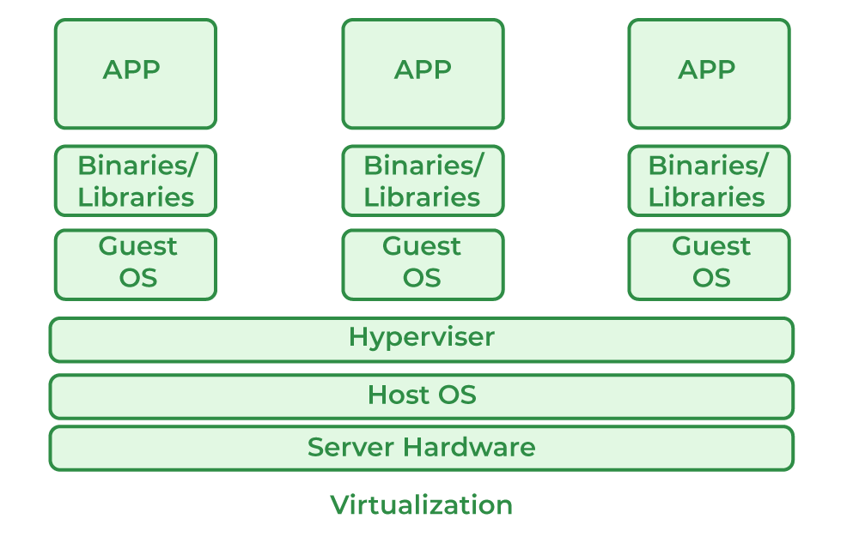
Virtualization
Virtualization is a process that allows a computer to share its hardware resources with multiple digitally separated environments.
Each virtualized environment runs within its allocated resources, such as memory, processing power, and storage.
With virtualization, organizations can switch between different operating systems on the same server without rebooting.

Slide 73
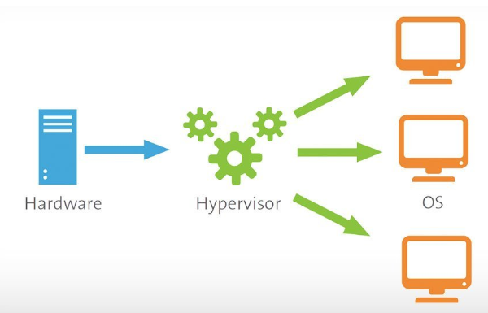
A hypervisor is a software that you can use to run multiple virtual machines on a single physical machine.
Every virtual machine has its own operating system and applications.
The hypervisor allocates the underlying physical computing resources such as CPU and memory to individual virtual machines as required.

Slide 74
How does a hypervisor work?
System administrators install the hypervisor software on physical servers.
The hypervisor loads the virtual machine images to create multiple virtual operating systems.
The physical machine is known as a host, and the virtual operating systems are guests.

Slide 75
Resource allocation
The hypervisor ensures that each virtual machine receives the allocated resources as configured. It does so by acting as an intermediary between guest machines and the underlying physical hardware.
The hypervisor relays requests for processing power, memory, storage, and other resources to the host machine in several ways, including API calls.
An API is a software communication method that allows different applications to exchange data.

Slide 76
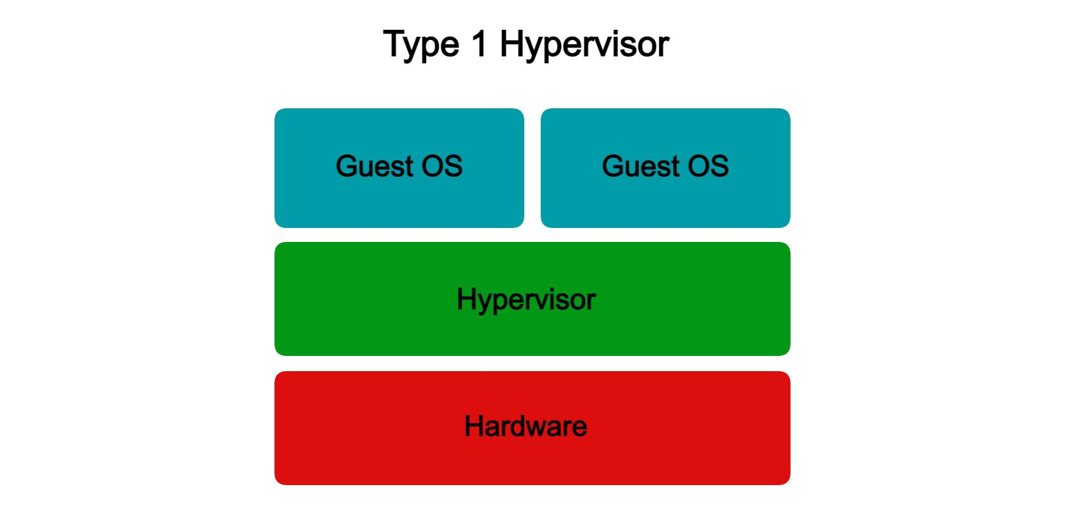
Type 1 hypervisor
The type 1 hypervisor sits on top of the metal server and has direct access to the hardware resources. Because of this, the type 1 hypervisor is also known as a bare-metal hypervisor. The host machine does not have an operating system installed in a bare-metal hypervisor setup. Instead, the hypervisor software acts as a lightweight operating system.
VMware ESXi, Microsoft Hyper-V (bare-metal version), KVM, Citrix XenServer.

Slide 77
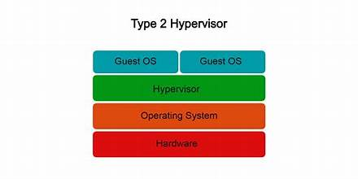
Type 2 hypervisor
The type 2 hypervisor is a hypervisor program installed on a host operating system. It is also known as a hosted or embedded hypervisor. Like other software applications, hosted hypervisors do not have complete control of the computer resources. Instead, the system administrator allocates the resources for the hosted hypervisor, which it distributes to the virtual machines.

Slide 78
When dealing with cloud providers, it’s important to understand how they implement virtualization and what security controls they apply to protect the virtualization layer.
This is because vulnerabilities at the virtualization layer could potentially allow attackers to bypass isolation and gain unauthorized access to other tenants’ data or resources.

Slide 79
Both PaaS (Platform as a Service) and SaaS (Software as a Service) platforms use a host abstraction layer to hide the underlying host operating system from end users.
SaaS:
End users only see the final application (e.g., Gmail, Salesforce).
The host abstraction layer is completely invisible to them.
Only developers and the CSP’s operations team can interact with it for maintenance, patching, and scaling.

Slide 80
PaaS:
Users (developers) are given indirect access to the host abstraction layer.
This access comes via platform APIs (e.g., database services, runtime environments, messaging queues).
These APIs internally communicate with the host abstraction layer, allowing developers to build, deploy, and manage applications without dealing directly with the OS or hardware.

Slide 81
In short, if you are a SaaS or a PaaS customer, you are relying on he CSP to provide a secure host platform on which the SaaS or PaaS application is developed and deployed by the CSP and you, respectively.

Slide 82
What is a Tenant?
A tenant is basically a customer (organization or individual) that is using a shared cloud service.
In multi-tenant environments, multiple tenants share the same infrastructure (servers, storage, networking, virtualization layer), but each tenant’s data and applications are logically isolated from the others.

Slide 83
Example in Different Cloud Models:
SaaS
Many companies may use the same SaaS platform (e.g., Microsoft 365, Salesforce).
Each company is a tenant.
They share the same underlying infrastructure, but their data is isolated.
PaaS
Multiple developers or organizations use the same platform services (e.g., Google App Engine, AWS Elastic Beanstalk).
Each developer group is a tenant, running apps on the same hardware and virtualization layer.
IaaS
Customers renting VMs or storage on the same physical servers are different tenants.
The hypervisor ensures each tenant’s VM is isolated from others.

Slide 84
Virtualization-Cloud
Virtualization uses specialized software, called a hypervisor, to create several cloud instances or virtual machines on one physical computer.
Cloud instances or virtual machines
After you install virtualization software on your computer, you can create one or more virtual machines. You can access the virtual machines in the same way that you access other applications on your computer. Your computer is called the host, and the virtual machine is called the guest. Several guests can run on the host. Each guest has its own operating system, which can be the same or different from the host operating system.

Slide 85
IaaS Host Security
IaaS customers are primarily responsible for securing the hosts provisioned in the cloud.
Given that almost all IaaS services available today employ virtualization at the host layer, host security in IaaS should be categorized as follows:
Virtualization software security
Customer guest OS or virtual server security

Slide 86
Virtualization Software Security
Since the CSP manages the virtualization software that sits on top of the hardware, customers will have neither visibility nor access to this software.
Hardware or OS virtualization enables the sharing of hardware resources across multiple guest VMs without interfering with each other so that you can safely run several operating systems and applications at the same time on a single computer.
IaaS services are using “bare metal hypervisor” technologies (also known as type 1 hypervisors), such as VMware ESX, Xen, Oracle VM, and Microsoft’s Hyper-V. These hypervisors support a variety of guest OSs, including Microsoft Windows, various Linux “flavors,” and Sun’s OpenSolaris.

Slide 87
Virtualization Software Security
No Customer Access
The CSP manages the virtualization software (the hypervisor) that runs on the hardware.
Customers have no visibility or control over this layer.
Why Virtualization Matters
Hardware/OS virtualization lets multiple VMs run on the same hardware safely, without interfering with each other.
This enables different operating systems and applications to coexist on one machine.
Bare Metal Hypervisors in IaaS
IaaS providers use Type-1 hypervisors (bare metal), such as VMware ESX, Xen, Oracle VM, Microsoft Hyper-V.
These support a variety of guest OSs like Windows, Linux variants, and OpenSolaris.
Key Point → Virtualization is the backbone of IaaS, but customers must rely fully on the CSP for its security.

Slide 88
Why Hypervisor Security is Critical
Isolation & Multi-tenancy
Hypervisors isolate customer VMs from one another.
Any weakness could let one tenant break into another tenant’s VM.
New Security Arms Race
Hackers vs CSPs are in a continuous battle over hypervisor vulnerabilities.
High-Risk Target
If virtualization is compromised, all VMs on that infrastructure could be exposed.
This could be catastrophic to every customer using that cloud.
Key Point → The hypervisor is the “crown jewel” for attackers; protecting it is absolutely critical.

Slide 89
Actions (Mitigation)
CSP Responsibilities
Enforce strong controls: restrict physical/logical access to hypervisors.
Apply strict policies and monitoring across virtualization layers.
Customer Responsibilities
Understand CSP’s controls for hypervisor protection.
Check compliance with your security standards, policies, and regulations.
Reality
CSPs often lack transparency in this area.
Customers must place trust in the CSP to deliver an isolated, secure guest OS.
Key Point → Security is mostly on the CSP’s shoulders, but customers should demand clarity through compliance checks, audits, and contracts.

Slide 90
Threats to the hypervisor
1. Integrity and Availability Threats
If a cloud provider’s hypervisor (e.g., VMware ESXi, KVM, or Hyper-V) is compromised, attackers could bring down all hosted virtual machines (VMs).
Example: Imagine a data center hosting hundreds of customer applications. If the hypervisor crashes, all these VMs stop working, causing downtime for banks, hospitals, or e-commerce platforms running on them.

Slide 91
2. Malicious Insider Attack
“A vulnerable hypervisor could expose all user domains to malicious insiders.” Example: If an administrator at a hosting provider abuses a hypervisor vulnerability, they could gain unauthorized access to customers’ VMs.
For instance, an insider could steal financial data from one tenant’s VM or plant malware in another.
3. Subversion Attacks
Hypervisors can be tricked into running code at a higher privilege level. Example: An attacker uploads a malicious VM image to a cloud platform. This VM exploits a flaw in the hypervisor to gain control of the host. Once successful, the attacker can control other tenants’ VMs as well.

Slide 92
Blue Pill Attack (real research demo)
The “Blue Pill” attack (demonstrated by security researcher Joanna Rutkowska) shows how attackers can install a malicious hypervisor beneath the operating system without detection.
Example: Suppose your laptop OS is running normally. An attacker exploits a CPU virtualization feature to slip in a hidden hypervisor (“Blue Pill”).
Your OS then unknowingly runs as a VM inside this hidden hypervisor. The attacker now controls your system without you realizing it.

Slide 93
Downtime threat = all VMs crash.
Insider threat = admins exploit hypervisor bugs.
Subversion attack = malicious VM breaks out and takes over.
Blue Pill = OS gets trapped in a fake hypervisor.

Slide 94
Virtual Server Security
Scenario----A company using AWS EC2 (IaaS)
1. Customer Access & Responsibility
The company rents EC2 instances (virtual servers) running Linux and Windows.
AWS provides the hypervisor isolation (so one customer’s VM can’t directly access another’s).
But the company is responsible for patching the OS, installing antivirus, configuring firewalls, and securing applications. Example: If the company leaves the VM unpatched, a hacker could exploit vulnerabilities in Windows Server and take control.

Slide 95
2. Attack Surface – Public Access
Since virtual servers can be connected to the internet, attackers can attempt brute-force login, exploit weak passwords, or scan for open ports.
Example: An attacker finds port 3389 (RDP for Windows) left open with a weak password → gains admin access.
3. Cloud Service Provider (CSP) Measures
AWS (or Azure, GCP) often blocks unnecessary ports by default and recommends secure methods like SSH (port 22) or HTTPS for access. 👉 Example: Admins should only allow SSH from trusted IP addresses, not the whole internet

Slide 96
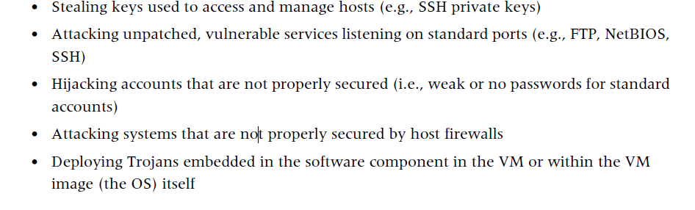
Some of the new host security threats in the public IaaS include:

Slide 97
Some recommendations:
1. Secure Configuration & Hardened Images
What it means:
Don’t use a “default” operating system image (like a fresh Windows/Linux install) that comes with many unnecessary services enabled.
Instead, create a hardened image: a stripped-down, locked-down version of the OS that has only what your application needs.

Slide 98
Example Scenario
Suppose you’re building a web application in the cloud:
Default way (less secure):
You launch a standard Ubuntu VM from AWS.
By default, it may come with packages like FTP, mail services, NFS, and other unused utilities.
An attacker can try to exploit vulnerabilities in these unused services, even if you never use them.
Hardened way (more secure):
You build a custom VM image (base image) that has:
Only the Linux OS kernel,
Your Apache web server,
And the database client needed to connect to your DB.
You remove/disable everything else (FTP, mail, NFS, printing).
Now, even if attackers scan your server, they find only one entry point (HTTP/HTTPS) — reducing the chance of attack.

Slide 99
2. Image Integrity & Inventory
Track and manage all VM images and OS versions in use.
Even if you use an image from the cloud provider (AWS AMI, Azure Marketplace image), subject it to the same hardening and verification as your internal servers.
Best: Maintain your own enterprise-approved base images.
Protect hardened images from unauthorized changes.

Slide 100
3. Key & Credential Management
Safeguard private keys used for SSH or API access.
Never embed passwords or API keys inside VM images.
Use encryption/decryption keys only when needed; keep them isolated from the hosted cloud whenever possible.
For continuous data-processing applications, minimize risk by restricting key exposure to only runtime use.
Example: Use AWS KMS, HashiCorp Vault, or Azure Key Vault to manage keys separately instead of hardcoding them in VM images.

Slide 101
4. Authentication & Access Control
Disable password-based login for shell access; use SSH keys instead.
Require passwords or MFA for privilege escalation (sudo, RBAC, SELinux roles).
Apply principle of least privilege for user accounts.
5. Network & Service Hardening
Run a host firewall and open only the minimum required ports (e.g., 80/443 for web, 22 for SSH).
Disable unused network services (FTP, NFS, print services, DB if not needed).

Slide 102
6. Monitoring & Logging
Enable system auditing and security event logging.
Forward logs to a dedicated, isolated log server for tamper-resistance.
Apply strong access controls to log servers.
Regularly review logs for suspicious activity.
7. Incident Response
If compromise is suspected:
Shut down the affected instance.
Perform forensics on a clean system, not the compromised one.

Slide 103
Infrastructure Security: The Application Level
1. Why it’s critical
Applications are the front door for users and attackers alike.
Even if the host VM and hypervisor are well secured, a poorly coded or misconfigured application can still be exploited.
Example: A web app with SQL Injection vulnerability allows attackers to steal customer data, even though the VM is hardened.

Slide 104
2. Changing context in the cloud
Traditional security programs often focused on securing internal, standalone applications.
Cloud deployment means applications are exposed to the internet, so new risks must be considered:
Multi-tenancy (apps sharing infrastructure with others).
Elastic scaling (more components, containers, APIs).
Shared responsibility (CSP secures infrastructure, you secure the app).
3. Application security spectrum
Standalone Apps → single user, limited exposure.
Enterprise Web Apps → large-scale, multi-user, internet-facing (e.g., e-commerce, CMS, customer portals).
Cloud mainly hosts the second type, which has a larger attack surface.

Slide 105
4. Development practices
Many organizations build apps with web frameworks: PHP, .NET, J2EE, Ruby on Rails, Python Django/Flask, etc.
Each framework introduces potential risks if not coded securely:
PHP → historically common SQL injection & XSS flaws.
.NET/J2EE → misconfigured authentication or insecure deserialization.
Python/Ruby → dependency vulnerabilities in 3rd-party packages.
5. Historical shift in attacks
Before 2007, attackers mainly targeted OS and network vulnerabilities.
Since then, web apps became the prime target because they directly expose sensitive data (financial records, user credentials, business logic).
Today, most breaches involve application-level exploits like:
SQL Injection
Cross-Site Scripting (XSS)
Insecure Authentication / Session Hijacking
API Exploits

Slide 106
Example in practice: A company hosts an online shopping app on AWS.
If the Linux VM is hardened but the shopping cart application has poor input validation, an attacker can inject SQL commands to extract credit card data.
This shows why app security must be part of the cloud security program — not just VM and hypervisor hardening.

Slide 107
XSS(cross-site scripting (XSS)
Advances in cross-site scripting (XSS) and other attacks have demonstrated that criminals looking for financial gain can exploit vulnerabilities resulting from web programming errors as new ways to penetrate important organizations.
XSS (Cross-Site Scripting) is a type of security vulnerability commonly found in web applications.
It allows attackers to inject malicious scripts into webpages viewed by other users.
XSS attacks occur when an application includes user input in the output it generates without proper validation or escaping

Slide 108
There are three main types of XSS:
Stored XSS (Persistent XSS):
The malicious script is permanently stored on the target server (e.g., in a database or a message board).
When users retrieve the data, the script is executed in their browsers.

Slide 109
Reflected XSS (Non-Persistent XSS):
The malicious script is reflected off a web server, such as in an error message or search result.
The attacker needs to trick users into clicking on a maliciously crafted URL to execute the script.

Slide 110
DOM-based XSS:
The vulnerability lies in the client-side scripts.
It occurs when the web application's client-side scripts modify the page's Document Object Model (DOM) in an unsafe way.

Slide 111
Browser Security in Cloud Application Security
Why browsers matter
The browser is now the main client for cloud apps (web portals, SaaS dashboards, e-commerce sites, etc.).
Any compromise in the browser → attacker can steal login credentials, session cookies, or inject malicious code into cloud applications.
Therefore, end-to-end security = Cloud App Security + Browser Security.

Slide 112
Common Browser-Based Threats
Phishing Attacks – tricking users into entering credentials on fake cloud login pages.
Cross-Site Scripting (XSS) – attacker injects malicious scripts into a web app, which then execute in the user’s browser.
Session Hijacking – stealing cookies to impersonate a logged-in user.
Malicious Browser Extensions – capturing keystrokes or stealing tokens.
Drive-by Downloads – silently installing malware through compromised sites.

Slide 113
Best Practices for Browser Security in Cloud Use
Best Practices for Browser Security in Cloud Use
Use HTTPS/TLS everywhere → prevents eavesdropping and tampering.
Enable Content Security Policy (CSP) → blocks malicious script injection.
Regularly patch browsers → fix known vulnerabilities quickly.
Use MFA (multi-factor authentication) → reduces impact of stolen credentials.
Disable weak plugins/extensions → allow only trusted ones.
Enforce secure cookies & SameSite flags → protect against session hijacking.
Educate users → awareness of phishing & malicious pop-ups.

Slide 114
Application-Level Security Threats
According to SANS,‖ web application vulnerabilities in open source as well as custom-built applications accounted for almost half the total number of vulnerabilities discovered between November 2006 and October 2007.
The existing threats exploit well-known application vulnerabilities including cross-site scripting (XSS), SQL injection, malicious file execution, and other vulnerabilities resulting from programming errors and design flaws

Slide 115
Armed with knowledge and tools, hackers are constantly scanning web applications (accessible from the Internet) for application vulnerabilities.
They are then exploiting the vulnerabilities they discover for various illegal activities including financial fraud, intellectual property theft, converting trusted websites into malicious servers serving client-side exploits, and phishing scams.
All web frameworks and all types of web applications are at risk of web application security defects, ranging from insufficient validation to application logic errors.

Slide 116
SQL injection
SQL injection is a type of cyber attack that targets databases through web applications.
It occurs when an attacker manipulates SQL queries by inserting malicious code into input fields, allowing unauthorized access to the database and potentially leading to data theft, modification, or deletion.

Slide 117
Solution
1. Combination of security controls
It suggests using perimeter security controls (like firewalls, intrusion detection/prevention systems) along with network- and host-based access controls (like authentication, authorization, and monitoring at both network and server level).
Goal: Protect web applications that are deployed in tightly controlled environments (corporate intranets or private clouds) against external hackers.
2. Public cloud challenges
When web applications are deployed in a public cloud (instead of private or intranet environments), they face a higher threat level.
They are more exposed to attacks, and hackers may exploit them for fraudulent or illegal activities.

Slide 118
3. Security in the cloud (SPI model)
In the SPI model (Software as a Service, Platform as a Service, Infrastructure as a Service), applications must be designed with an Internet threat model in mind.
That means assuming exposure to global threats (DDoS, phishing, malware injection, etc.).
Security should not be an afterthought—it must be built into every phase of the Software Development Life Cycle (SDLC) (planning, design, development, testing, deployment, and maintenance).

Slide 119
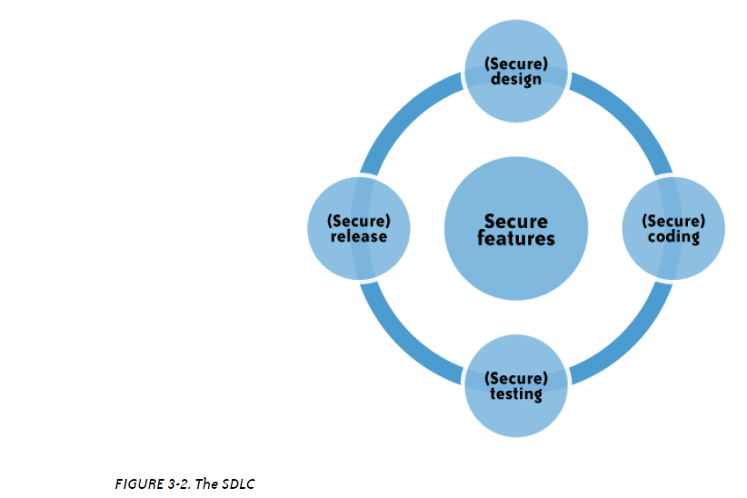

Slide 120
perimeter security controls
Perimeter security controls are protective measures designed to safeguard the boundaries of a network or physical location from unauthorized access and external threats.
These controls act as the first line of defense, ensuring that malicious traffic or attackers are blocked before they can penetrate deeper into the system.
Eg : Firewalls
Intrusion Detection and Prevention Systems (IDPS):

Slide 121
DoS and EDoS
1. Application-level DoS/DDoS attacks
These are not just network floods but application-level attacks.
They can disrupt cloud services for an extended time by overwhelming servers with fake or excessive requests.
2. Origin of attacks
They usually come from compromised systems on the Internet:
Hackers hijack vulnerable computers (infected with viruses, worms, or malware).
Sometimes, even unprotected servers are taken over and used in the attack.
When multiple hijacked systems are used together, it becomes a DDoS (Distributed DoS) attack.

Slide 122
3. Challenge: malicious traffic vs. real traffic
The big problem: these malicious requests often look very similar to legitimate traffic.
This makes it extremely hard to filter out only the bad traffic without accidentally blocking real users.

Slide 123
EDOS
Economic angle: EDoS
Since attackers exploit the billing structure of cloud computing, this is not just a denial of service—it’s a denial of sustainability.
That’s why it’s called EDoS (Economic Denial of Sustainability).
Essentially, the attacker forces the victim to pay massive cloud bills, making the service financially unsustainable, even if it doesn’t fully crash.

Slide 124
A normal DoS attack just makes your system unavailable.An EDoS attack makes you go bankrupt by running up your cloud bills (through excessive resource consumption).

Slide 125
End User Responsibility
Cloud customers are responsible for securing their Internet-connected devices and practicing safe browsing habits.
Security Measures: Essential protection includes using anti-malware, antivirus software, personal firewalls, security patches, and intrusion prevention system (IPS) software.
Browser as the Operating System: Browsers have become key tools for accessing cloud services, making them critical points for security.
Vulnerability of Browsers: Internet browsers are prone to software vulnerabilities that expose users to potential attacks.

Slide 126
Browser Hygiene: To ensure security, users must maintain good browser hygiene, including keeping browsers patched and up to date.
Popular Browsers: Major browsers like Internet Explorer, Firefox, and Safari require frequent updates to protect against security threats.
Auto-Update Feature: Users should enable auto-updates for their browsers to ensure timely installation of security patches.
Browser Security Add-ons: Although browser security add-ons aren't widely available, manual vigilance for updates is essential.

Slide 127
Regular Patch Updates: Customers should regularly check browser vendor websites for security updates and install patches promptly.
End-to-End Security: Achieving comprehensive security in the cloud involves both maintaining secure browsers and staying informed about potential threats.

Slide 128
Who Is Responsible for Web Application Security in the Cloud?
Depending on the cloud services delivery model (SPI) and service-level agreement (SLA), the scope of security responsibilities will fall on the shoulders of both the customer and the cloud provider.
The key is to understand what your security responsibilities are versus those of the CSP.
In that context, recent security surveys have highlighted the fact that lack of transparency in security controls and practices employed by CSPs is a barrier to cloud adoption.

Slide 129
To start with, cloud customers do not have the transparency required in the area of software vulnerabilities in cloud services.
This prevents customers from managing the operational risk that might come with the vulnerabilities.
Furthermore, by treating their software as proprietary, CSPs are impeding security researchers from analyzing the software for security flaws and bugs.
Due to this lack of transparency, customers are left with no choice but to trust their CSPs to disclose any new vulnerability that may affect the confidentiality, integrity, or availability of their application.

Slide 130
SaaS Application Security
The SaaS model dictates that the provider manages the entire suite of applications delivered to users.
Therefore, SaaS providers are largely responsible for securing the applications and components they offer to customers.
Customers are usually responsible for operational security functions, including user and access management as supported by the provider.
It is a common practice for prospective customers, usually under an NDA, to request information related to the provider’s security practices.
Some customers go to the extent of hiring independent security vendors to perform penetration testing of SaaS applications (with consent from the provider) to gain assurance independently.
However, penetration testing can be costly and not all providers agree to this type of verification.

Slide 131
Chapter 2 : Data Security and Storage

Slide 132
Data-in-transit
Data-at-rest
Processing of data, including multitenancy
Data lineage
Data provenance
Data remanence

Slide 133
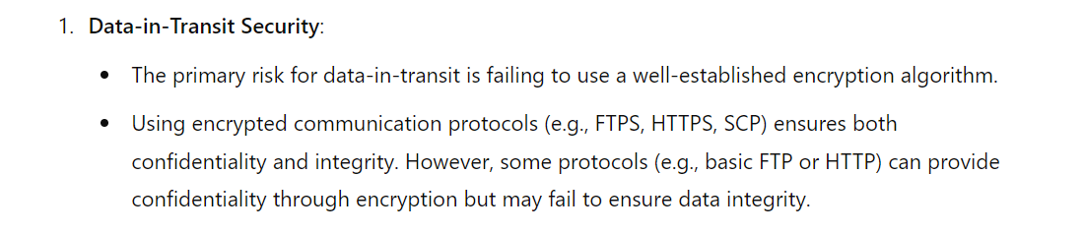
Aspects of Data Security

Slide 134
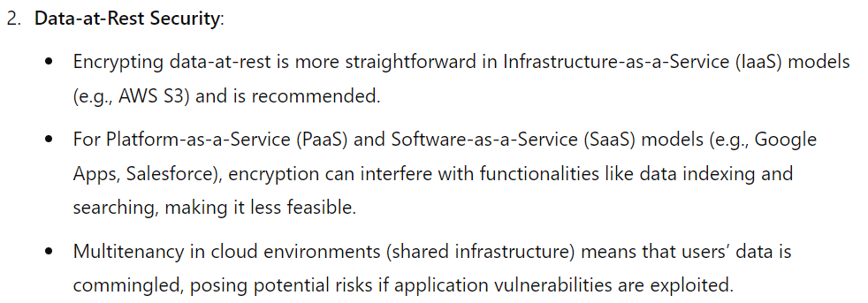

Slide 135
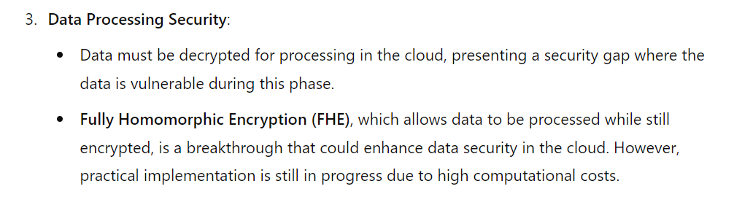

Slide 136
Example
Situation: A medical researcher wants to compute descriptive statistics on a population of lung cancer patients at a hospital.
Complication: The hospital is unable to share its private medical records with the researcher due to the HIPAA privacy rule.
Resolution: The hospital encrypts its sensitive data using a fully homomorphic encryption scheme, so that the data is protected while also able to be computed on.
Health Insurance Portability and Accountability Act

Slide 137
How It Works: The hospital homomorphically encrypts its medical records and sends them to the medical researcher’s cloud computing environment.
Because the data is encrypted, it is fully protected and private in the cloud.
Next, the researcher runs its analytical functions on the homomorphically-encrypted data in the cloud, manipulating the data while it remains encrypted.
Last, the researcher downloads the encrypted output, and decrypts the result to reveal the plaintext answer.
Notice that the sensitive medical record data is encrypted end-to-end, and is only decrypted when revealing the final answer behind organizational firewalls.

Slide 138
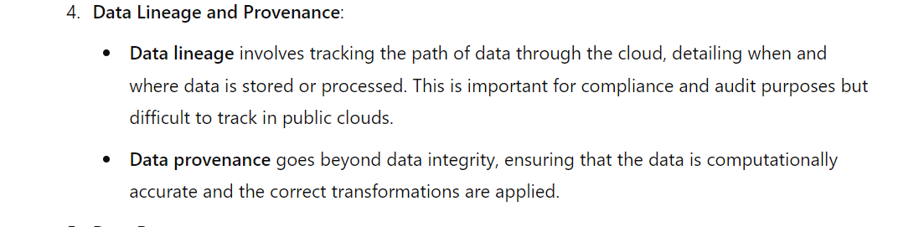

Slide 139
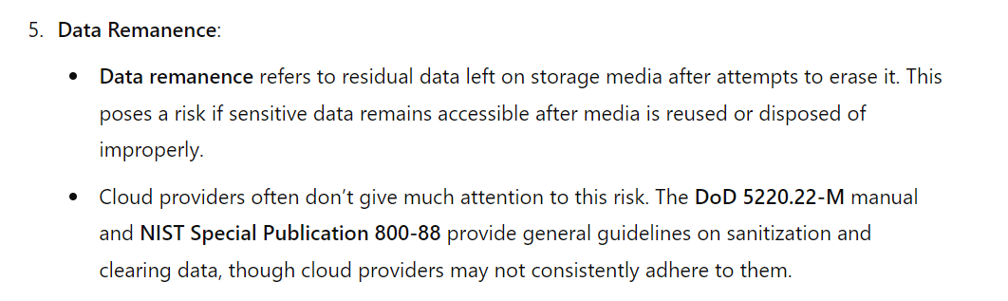

Slide 140
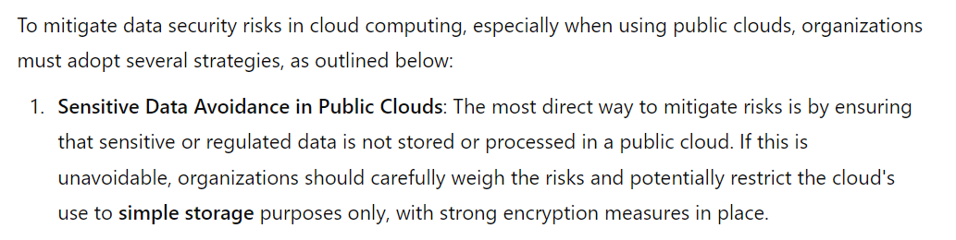
Data Security Mitigation

Slide 141
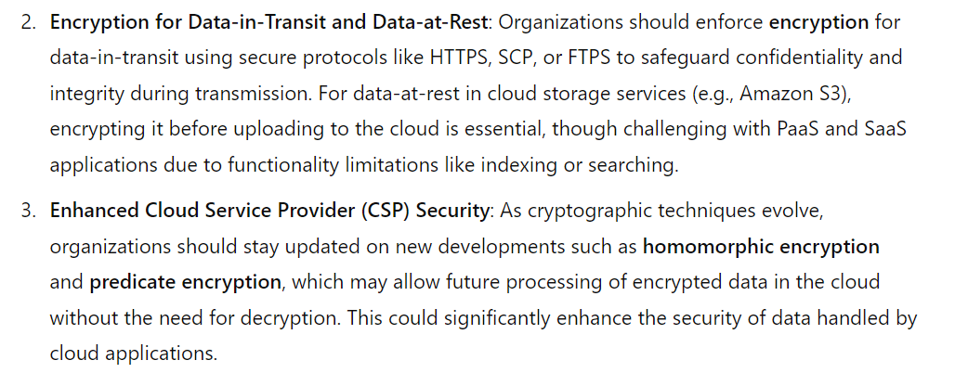

Slide 142
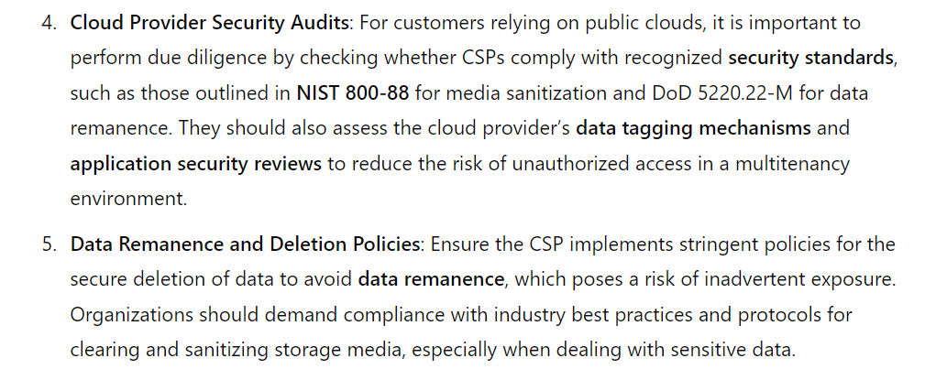

Slide 143
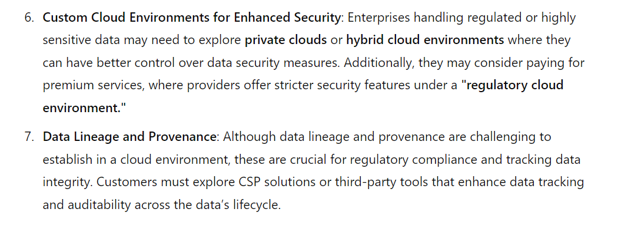

Slide 144
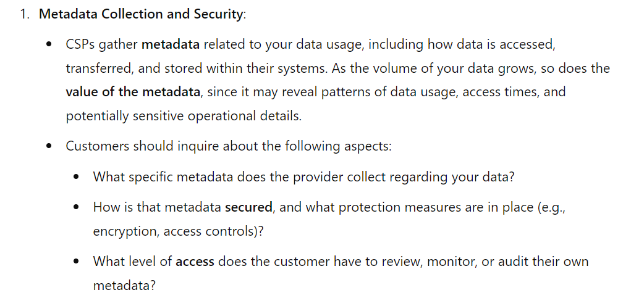
Provider Data and Its Security

Slide 145
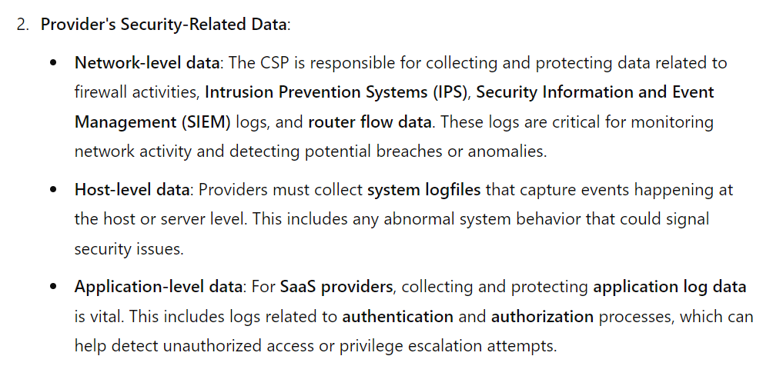

Slide 146
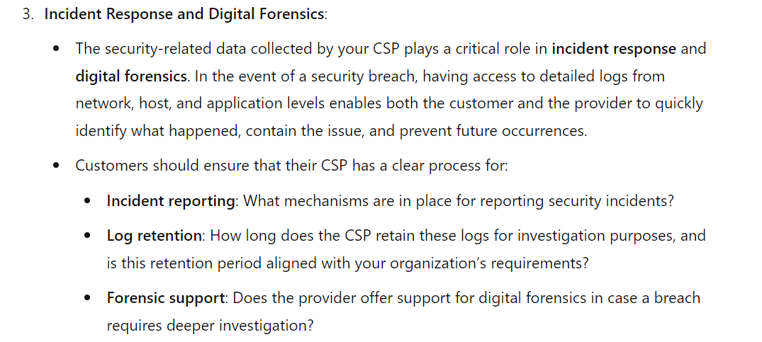

Slide 147
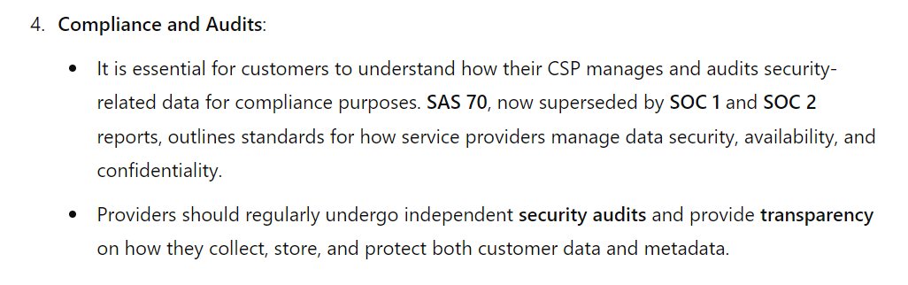

Slide 148
Storage
When storing data in the cloud under the Infrastructure-as-a-Service (IaaS) model, such as using storage services like Amazon S3, the same fundamental information security principles apply: confidentiality, integrity, and availability.
Each of these must be carefully managed to ensure the protection and security of your data. Here's how these principles apply to cloud-based storage:

Slide 149
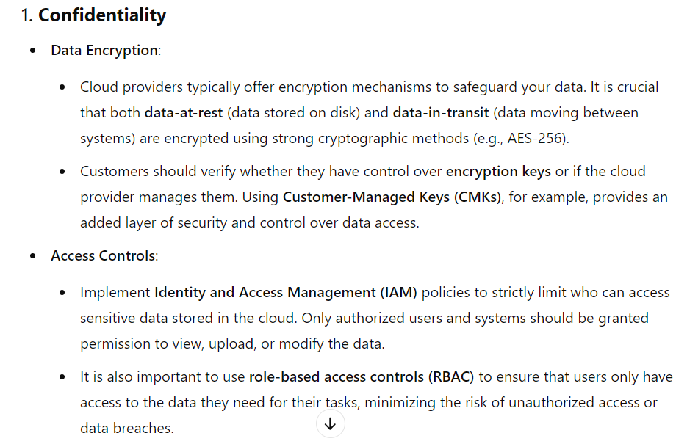

Slide 150
Storage
Encryption Algorithm
Key Strength –Length
It depends, and specifically, it depends on which CSP you are using.
For example, EMC’s MozyEnterprise does encrypt a customer’s data.
However, AWS S3 does not encrypt a customer’s data.
Customers are able to encrypt their own data themselves prior to uploading, but S3 does not provide encryption.

Slide 151
Symmetric encryption involves the use of a single secret key for both the encryption and decryption of data.
Only symmetric encryption has the speed and computational efficiency to handle encryption of large volumes of data.
It would be highly unusual to use an asymmetric algorithm for this encryption use case.

Slide 153
Key length
With symmetric encryption, the longer the key length (i.e., the greater number of bits in the key), the stronger the encryption.
Although long key lengths provide more protection, they are also more computationally intensive, and may strain the capabilities of computer processors.
What can be said is that key lengths should be a minimum of 112 bits for Triple DES (Data Encryption Standard) and 128- bits for AES (Advanced Encryption Standard)—both NIST-approved algorithms.

Slide 154
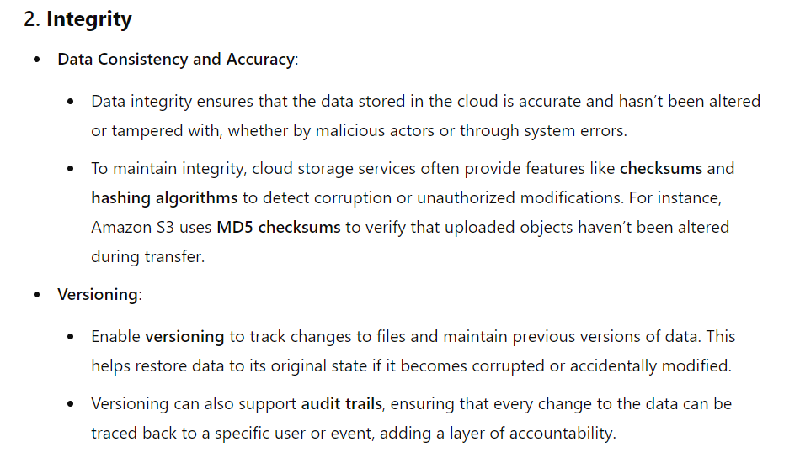

Slide 155
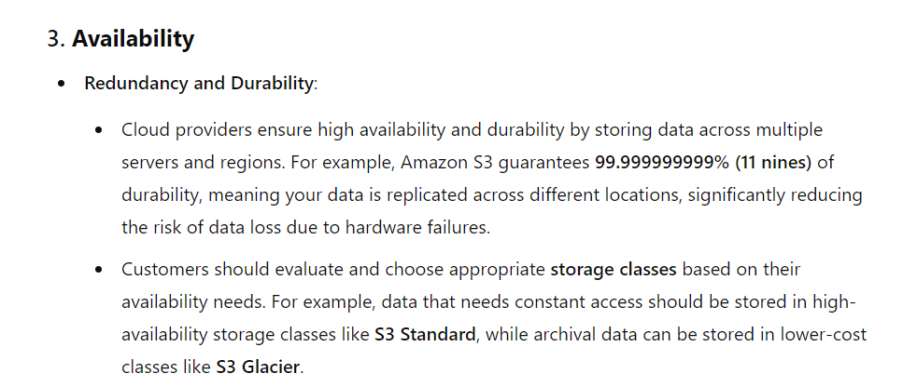

Slide 156
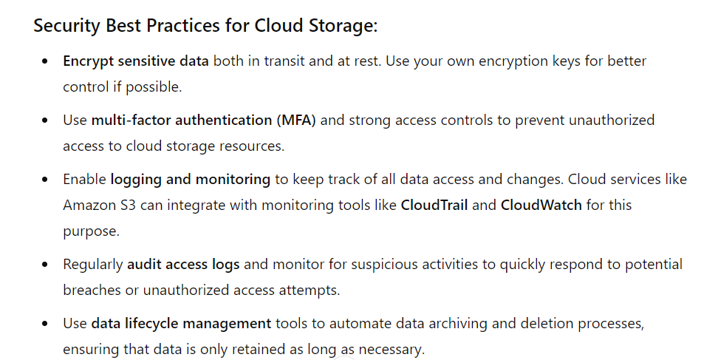

Slide 157
MODULE-3 Identity and Access Management

Slide 158
THIS CHAPTER PRESENTS THE CURRENT STATE OF THE PRACTICE OF
IDENTITY AND ACCESS management (IAM) and support for IAM features that aid in Authentication, Authorization, and Auditing (AAA) of users accessing cloud services.

Slide 159
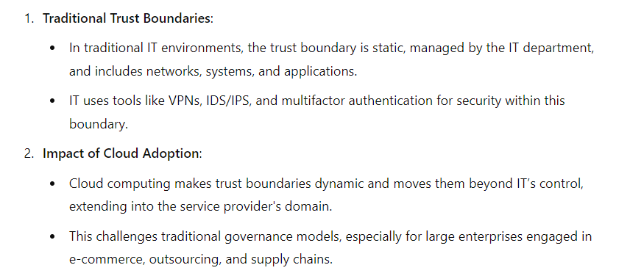
Trust Boundaries and IAM

Slide 160
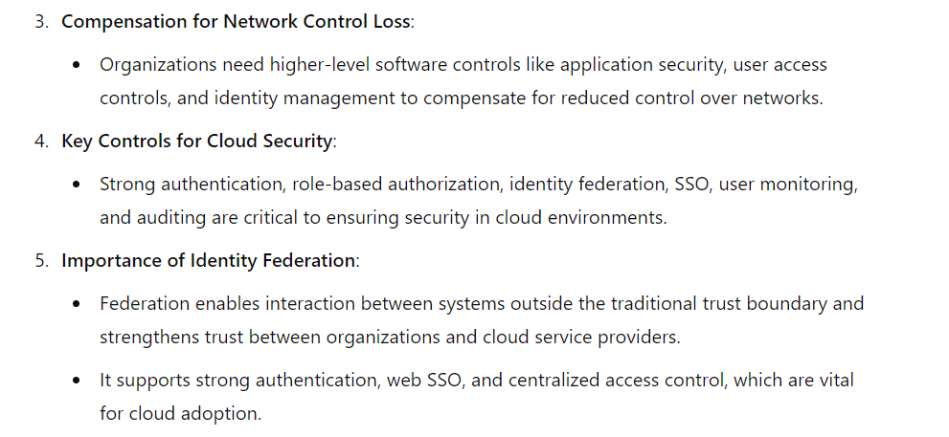

Slide 161
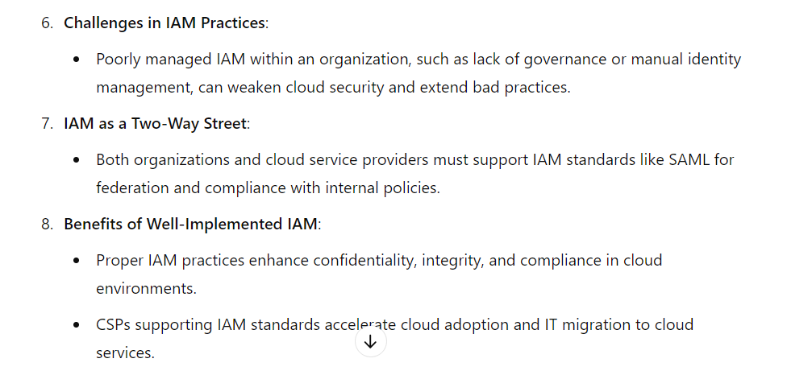

Slide 162
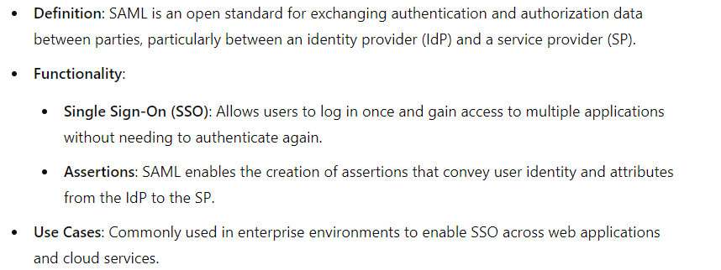
SAML (Security Assertion Markup Language)

Slide 163
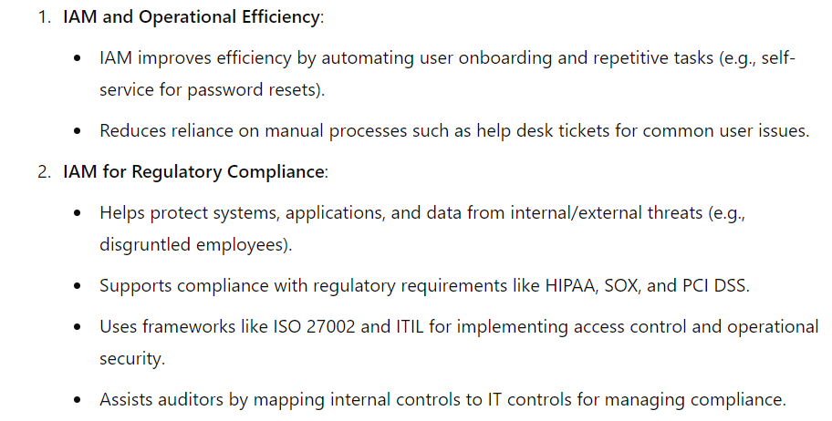
Why IAM?

Slide 164
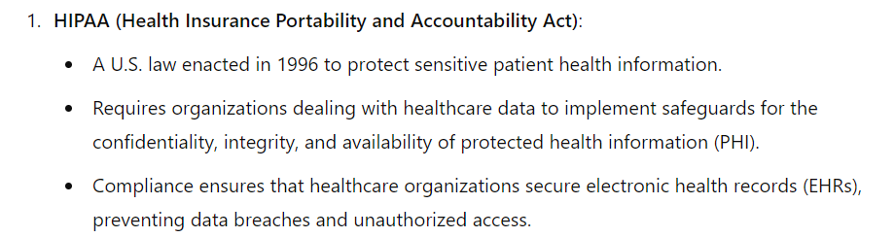

Slide 165
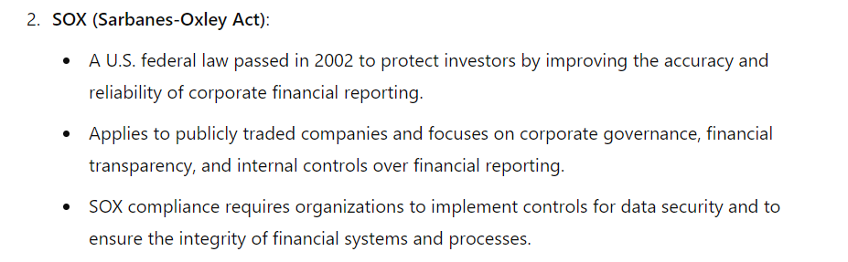

Slide 166
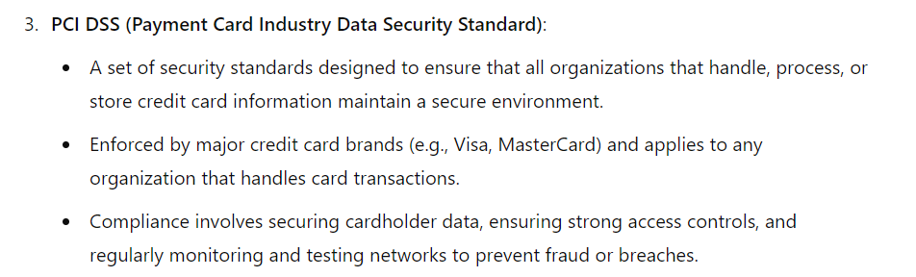

Slide 167
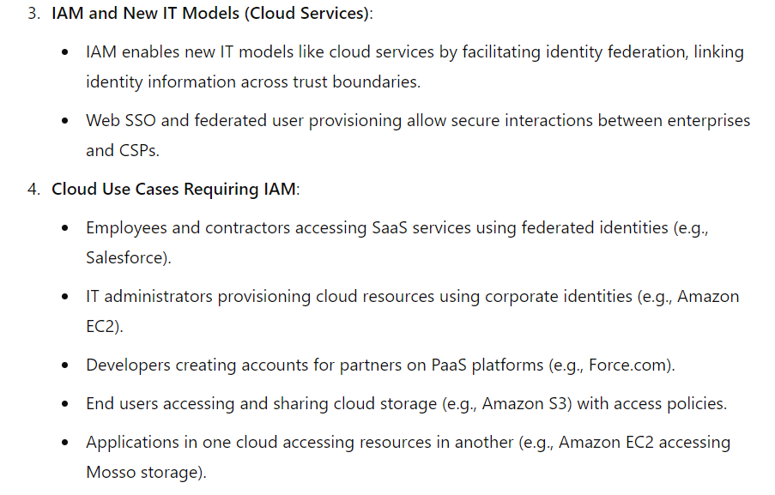

Slide 168
Web Single Sign-On (Web SSO) is a user authentication process that allows users to log in once and gain access to multiple related applications or services without needing to re-enter credentials for each one.

Slide 169
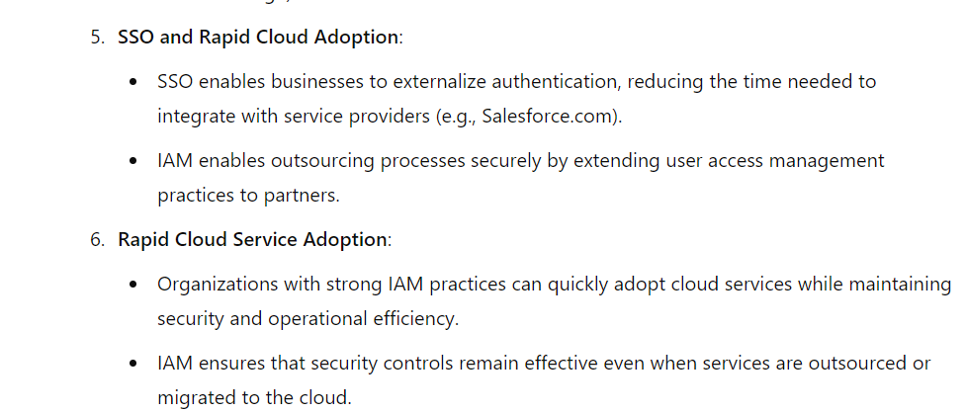

Slide 170
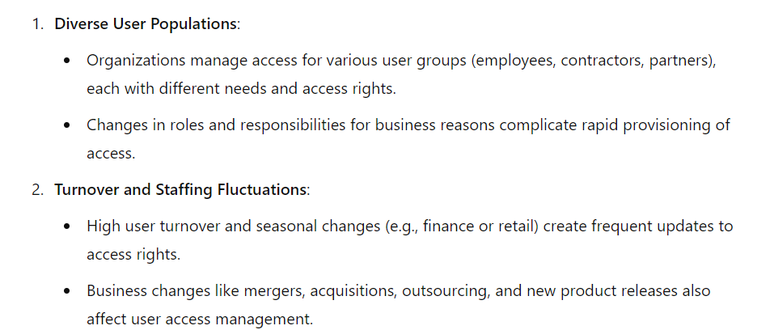
IAM Challenges

Slide 171
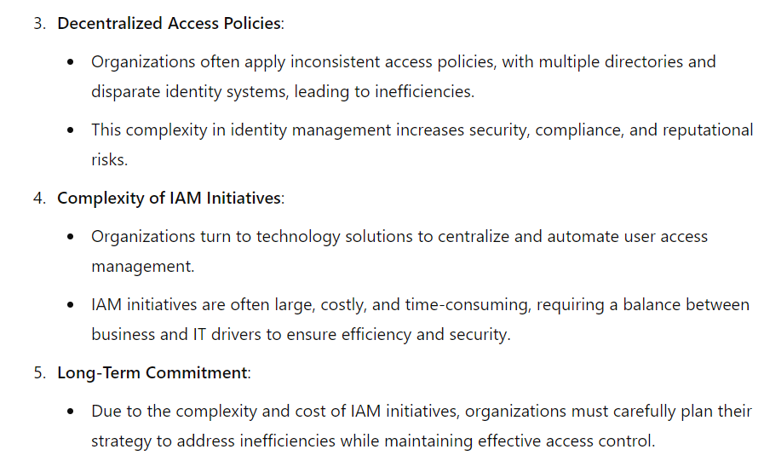

Slide 172
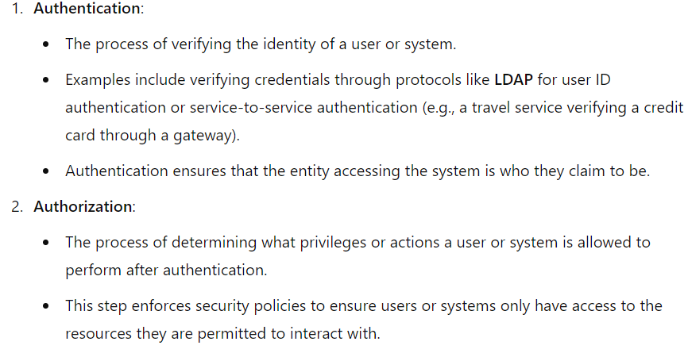
IAM (Identity and Access Management) definitions for key functions:

Slide 173
LDAP (Lightweight Directory Access Protocol) is an open, vendor-neutral protocol used for accessing and maintaining distributed directory information services over an IP network.
Directory services provide a centralized way to store information about users, systems, networks, and applications in an organized, hierarchical manner.
LDAP is widely used for authentication and authorization, particularly in corporate environments.

Slide 174
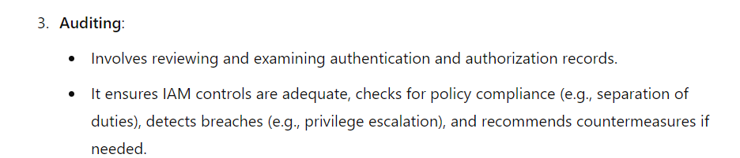

Slide 175

IAM Architecture and Practice

Slide 176


Slide 178

IAM processes support the following operational activities:

Slide 179


Slide 180


Slide 181
Identity life cycle

Slide 182

Getting Ready for the Cloud

Slide 183


Slide 184
Relevant IAM Standards and Protocols for Cloud Services
IAM Standards and Specifications for Organizations
Security Assertion Markup Language (SAML)
Service Provisioning Markup Language (SPML)
eXensible Access Control Markup Language (XACML)
Open Authentication (OAuth)

Slide 185

Four major challenges in user and access management faced by cloud users:

Slide 186

Security Assertion Markup Language (SAML)

Slide 187


Slide 188
SSO transaction steps using SAML

Slide 189


Slide 190


Slide 191

SPML Service Provisioning Markup Language

Slide 192


Slide 193
SPML USE CASE

Slide 194

HR System of Record:
Acts as the requesting authority.
It is an SPML web services client that initiates the provisioning request for a user account (e.g., a new employee or an update to an existing user’s account).

Slide 195


Slide 196

XAML-eXtensible Access Control Markup Language

Slide 197
eXensible Access Control Markup Language (XACML)
XACML is an OASIS-ratified, general-purpose, XML-based access control language for policy management and access decisions.
It provides an XML schema for a general policy language which is used to protect any kind of resource and make access decisions over these resources.
The XACML standard not only gives the model of the policy language, but also proposes a processing environment model to manage the policies and to conclude the access decisions.

Slide 198
XACML
XACML-eXtensible Access Control Markup Language
The XACML context also specifies the request/response protocol that the application environment can use to communicate with the decision point.
The response to an access request is also specified using XML.
In a centrally managed IAM architecture, application-specific authorization models (silos) make it difficult to state the access rights of individual users across all applications.
Hence,the goal of XACML is to provide a standardized language, a method of access control, and policy enforcement across all applications that implement a common authorization standard.
These authorization decisions are based on various authorization policies and rules centered on the user role and job function. In short, XACML allows for unified authorization policies.

Slide 199


Slide 200

STEPS-

Slide 201

XACML Architecture Diagram

Slide 202
Illustrates the interaction among various health care participants with unique roles (authorization privileges) accessing sensitive patient records stored in a health care application

Slide 203

The figure illustrates the following steps involved in the XACML process:

Slide 204


Slide 205
Open Authentication (OAuth)
OAuth is an emerging authentication standard that allows consumers to share their private resources (e.g., photos, videos, contact lists, bank accounts) stored on one CSP with another CSP without having to disclose the authentication information (e.g., username and password).
OAuth is an open protocol and it was created with the goal of enabling authorization via a secure application programming interface (API)—a simple and standard method for desktop, mobile, and web applications.

Slide 206
OAuth is a technological standard that allows you to authorize one app or service to sign in to another without divulging private information, such as passwords.
If you’ve ever received a message such as, “Sign in with Facebook?” or “Allow this application to access your account?” you’ve seen OAuth in action.
OAuth stands for Open Authorization—not authentication, as it’s sometimes assumed to be.
Authentication is a process that verifies your identity. OAuth does involve your identity, but its purpose is to grant permission to seamlessly connect to you with different apps and services without requiring you to create a new account.
OAuth provides that simplicity of experience by giving you the option to authorize two apps to share some of your data without revealing your credentials. It strikes a balance between convenience and security.

Slide 207
For application developers, OAuth is a method for publishing and interacting with protected data.
For CSPs, OAuth provides a way for users to access their data hosted by another provider while protecting their account credentials.
Google released a hybrid version of an OpenID and OAuth protocol that combines the authorization and authentication flow in fewer steps to enhance usability.
Google’s GData API recently announced support for OAuth.

Slide 208
Illustrates the sequence of interactions between customer or partner web application, Google services, and end user:

Slide 209


Slide 210


Slide 211
IAM Standards, Protocols, and Specifications for Consumers
OpenID
Information cards
Open Authentication (OATH)
Open Authentication API (OpenAuth)

Slide 212
OpenID
OpenID is an open, decentralized standard for user authentication and access control, allowing users to log on to many services with the same digital identity—i.e., a single sign-on user experience with services supporting OpenID.
As such, it replaces the common logon process that uses a logon username and password, by allowing a user to log on once and gain access to the resources of multiple software systems

Slide 213
OpenID is primarily targeted for consumer services offered by Internet companies including Google, eBay, Yahoo!, Microsoft, AOL, BBC, PayPal, and so on.
OpenID adoption for enterprise use (e.g., non-consumer use) is almost nonexistent due to trust issues; some researchers have revealed that OpenID could accelerate phishing attacks that can result in compromising user credentials.

Slide 214
Information cards
Information cards are another open standard for identity on the Web. The standard itself is directed by the Information Card Foundation, whose steering members include representatives from Google, Microsoft, PayPal, Oracle Novell, and Equifax.
The Foundations states that its mission is “to reduce the instance of identity theft by securing digital identities in place of traditional logons and passwords.”
The goal of this standard is to provide users with a safe, consistent, phishing-resistant user interface that doesn’t require a username and password.

Slide 215
People can use an information card digital identity across multiple sites for convenience without compromising their login information (similar to using an OpenID identity across multiple sites).
The Information Cards Protocol is designed for use in high-value scenarios, such as banking, where phishing resistance and support for secure authentication mechanisms such as smart cards are critical business requirements.

Slide 216
Any service provider can implement, issue, or accept information cards (also called i-cards). Information cards are composed using WS-* specifications instead of HTTP redirect, so the specifications are significantly more complicated than OpenID.
Even though this system offers great protection against identity theft and phishing, it still has a few issues that prevent it from achieving its mission.

Slide 217
The greatest problem with the system is that it only works if the website used by the consumer is participating and accepts information cards. If this affiliation is not present, the information card is useless.
As more and more websites accept information cards, the system will become more and more useful, but until that time, they have limited use.
For example, one can use a managed information card issued by Microsoft Windows Live ID to provide single sign-on to most of Microsoft’s sites, including MSDN, TechNet, Live, and Connect.

Slide 218

Open Authentication (OATH)
OATH is a collaborative effort of IT industry leaders aimed at providing an architecture reference for universal, strong authentication across all users and all devices over all networks.
The goal of this initiative is to address the three major authentication methods:

Slide 219
Open Authentication API (OpenAuth)
OpenAuth is an AOL-proprietary API that enables third-party websites and applications to authenticate AOL and AOL Instant Messenger (AIM) users through their websites and applications.
Using this authentication method, an AIM- or AOL-registered user can log on to a third-party website or application and access AOL services or new services built on top of AOL services.

Slide 220

According to AOL, the OpenAuth API provides the following features:

Slide 221
Cloud Identity Administration
Cloud identity administrative functions should focus on life cycle management of user identities in the cloud—provisioning, deprovisioning, identity federation, SSO, password or credentials management, profile management, and administrative management.

Slide 222

Module-4

Slide 223
Security Management in the Cloud
WITH THE ADOPTION OF PUBLIC CLOUD SERVICES, A LARGE PART OF YOUR NETWORK, system, applications, and data will move under third-party provider control.
The cloud services delivery model will create islands (clouds) of virtual perimeters as well as a security model with responsibilities shared between the customer and the cloud service provider (CSP).
This shared responsibility model will bring new security management challenges to the organization’s IT operations staff.
With that in mind, the first question a chief information security officer (CISO) must answer is whether she has adequate transparency from cloud services to manage the governance (shared responsibilities) and implementation of security management processes (preventive and detective controls) to assure the business that the data in the cloud is appropriately protected

Slide 224
The answer to this question has two parts: what security controls must the customer provide over and above the controls inherent in the cloud platform, and how must an enterprise’s security management tools and processes adapt to manage security in the cloud.
Both answers must be continually reevaluated based on the sensitivity of the data and the service-level changes over time.

Slide 225
USER -Responsibility
As a customer of the cloud, you should start with the exercise of understanding the trust boundary of your services in the cloud.
You should understand all the layers you own, touch, or interface with in the cloud service—network, host, application, database, storage, and web services including identity services .
You also need to understand the scope of IT system management and monitoring responsibilities that fall on your shoulders, including access, change, configuration, patch, and vulnerability management.

Slide 226

Security management and monitoring scope

Slide 227
Security management and monitoring scope
Mature IT organizations are known to employ security management frameworks, such as ISO/ IEC 27000 and the Information Technology Infrastructure Library (ITIL) service management framework.
These industry standard management frameworks provide guidance for planning and implementing a governance program with sustaining management processes that protect information assets

Slide 228
For example, ITIL gives a detailed description of a number of important IT practices with comprehensive checklists, tasks, and procedures that can be tailored to any IT organization.
A key tenet of ITIL, and one that is applicable to cloud computing, is that organizations (people, processes) and information systems are constantly changing.
Hence, management frameworks such as ITIL will help with the continuous service improvement that is necessary to align and realign IT services to changing business needs.
Continuous service improvement means identifying and implementing improvements to the IT services that support business processes such as sales force automation using a cloud service provider.

Slide 229


Slide 230
The ITIL life cycle in a enterprise

Slide 231
Security Management Standards
ITIL
ISO 27001/27002

Slide 232
The Information Technology Infrastructure Library (ITIL) is a set of best practices and guidelines that define an integrated, process-based approach for managing information technology services.
ITIL can be applied across almost every type of IT environment including cloud operating environment.
ITIL seeks to ensure that effective information security measures are taken at strategic, tactical, and operational levels.
Information security is considered an iterative process that must be controlled, planned, implemented, evaluated, and maintained.

Slide 233


Slide 234
ISO 27001/27002
ISO/IEC 27001 formally defines the mandatory requirements for an Information Security Management System (ISMS).
It is also a certification standard and uses ISO/IEC 27002 to indicate suitable information security controls within the ISMS.
However, since ISO/IEC 27002 is merely a code of practice/guideline rather than a certification standard

Slide 235
The ITIL, ISO/IEC 20000, and ISO/IEC 27001/27002 frameworks help IT organizations internalize and respond to basic questions such as:
How do I ensure that the current security levels are appropriate for your needs?
How do I apply a security baseline throughout your operation?
To that end, they help you to respond to the question: how do I ensure that my services are secure?

Slide 236

Security Management in the Cloud
After analyzing the management process disciplines across the ITIL and ISO frameworks, we (the authors) identified the following relevant processes as the recommended security management focus areas for securing services in the cloud:

